Slide 1

Wireless Networking
Ambuj Varshney
ambujv@nus.edu.sg
Notes:
++ Thank you for inviting me to give this talk
++ In this talk, I will present a pathway that can enable us to make wireless embedded systems ubiquitous. I will describe my previous research efforts that tackle the critical challenges that limit the growth of wireless embedded systems. These are related to the growing energy asymmetry that exists between sensing, computation and communication blocks on these platforms.
++ Finally, I will conclude my talk by covering the research agenda that I would like to work on as a faculty member.

Slide 2
Roadmap of the lecture today
General course information and updates
Let us review what we had covered in the last lecture
Radio signal propagation, attenuation and decibel
What are sensors, different type of sensing modality
Actuation and SensorTag Platform
Notes:
Here is the roadmap of the major topics that I am going to cover during the presentation. We have already covered the exponential growth of the internet of things; next, I will talk about the critical energy challenge that can severely hinder this massive growth and preventing us from realising this immense economic value enabled by the IoT.

Slide 3
Administration and Course Logistics
Notes:
++ Over the past few years, I have designed several backscatter and beyond backscatter systems that precisely overcome these critical challenges that have limited the widespread deployment of backscatter on IoT devices.
++ The research vision that I have pursued and would like to pursue as a faculty member is to enable a massive deployment of IoT devices by bridging the energy asymmetry between sensing, computation and communication blocks by designing novel platforms and communication mechanisms. I am going to describe some of my research contributions next.

Slide 4
Important Events and Deadlines
Event | Date
Lectures | Starting Week 1 (19th January)
Group formation and notification | End of Week 4
Tutorials | Begin Week 3 (29th January)
Assignment 1 | Demonstrate to TA’s Week 5 and 6
Assignment 2, 3 | TBA
Project submission | 26th April 2024 (EOD)
Final assessment | 29th April 2024

Slide 5
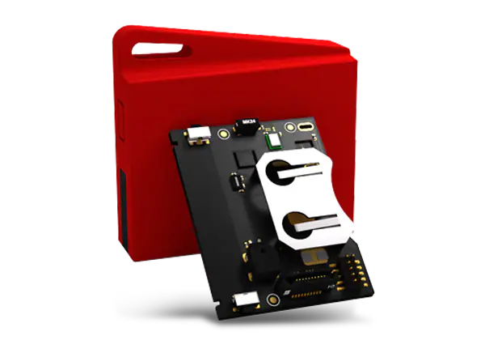
Collection of sensor tags and group formation
Sensor tag and Programmer: A wireless embedded device
For students who have formed group, please collect. Check email.
Sent out link to collect information regarding the group members
Difficulty finding group members? Use Piazza (again check email)
Next Wednesday: We will send out form to collect information of students finding difficult to form groups. Random ordering and formation of group on Thursday.
Notes:
++ We may all have heard of the term Internet of Things. So how are these wireless embedded systems related to the Internet of Things: Today, IoT includes a broad class of devices, including powerful platforms such as smartphones. However, it also includes more resource-constrained devices and what we call Wireless Embedded Systems, and in fact, I consider it to be one of the essential parts of the IoT ecosystem.
++ These are platforms equipped with a radio transceiver, sensor, microcontroller, and some form of energy storage. These platforms also often form a network, and sensor network as it is called has been an active area of research for the past two decades.
++ The research community has also developed wireless embedded platforms which we may know about, and these include: CMUCAM, which is an image sensor platform developed at Carnegie Mellon University, or Permamote is long life sensor platform from the lab I am associated with at UC Berkeley or Lorea which is a long-range backscatter platform that I had developed as part of my doctoral dissertation at Uppsala University. All of these are an example of Wireless Embedded Systems.

Slide 6
Roadmap of the lecture today
General course information and updates
Let us review what we had covered in the last lecture
Radio signal propagation, attenuation and decibel
What are sensors, different type of sensing modality
Actuation and SensorTag Platform
Notes:
Here is the roadmap of the major topics that I am going to cover during the presentation. We have already covered the exponential growth of the internet of things; next, I will talk about the critical energy challenge that can severely hinder this massive growth and preventing us from realising this immense economic value enabled by the IoT.

Slide 7
Let us recall what we covered in last lecture
Notes:
++ Over the past few years, I have designed several backscatter and beyond backscatter systems that precisely overcome these critical challenges that have limited the widespread deployment of backscatter on IoT devices.
++ The research vision that I have pursued and would like to pursue as a faculty member is to enable a massive deployment of IoT devices by bridging the energy asymmetry between sensing, computation and communication blocks by designing novel platforms and communication mechanisms. I am going to describe some of my research contributions next.

Slide 8

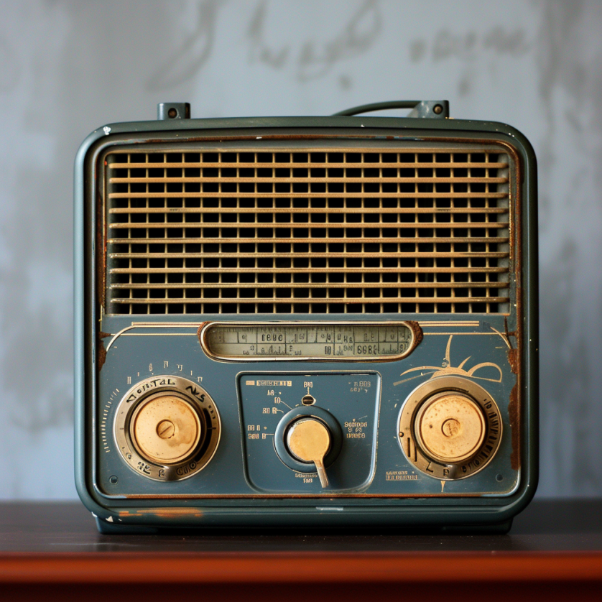

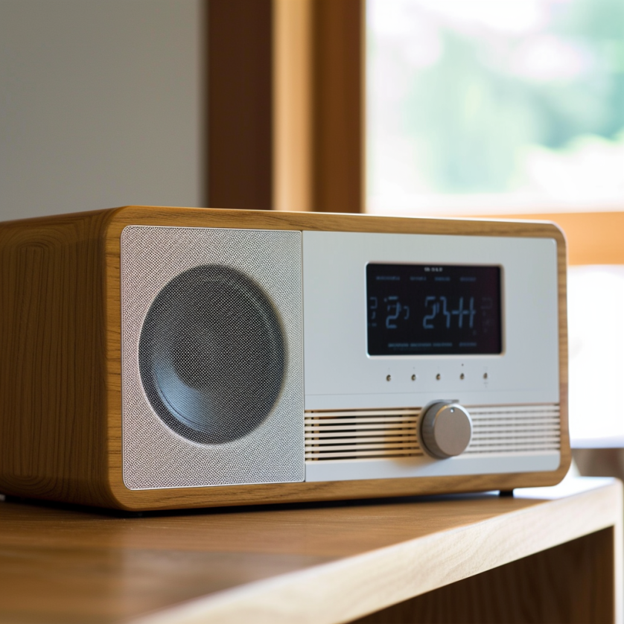
What does the term radio means?
Notes:
First, we look at the computational elements, and these consist of a microcontroller or an FPGA. Today, we find that these computational elements consume at least one order of magnitude higher power consumption when compared to the commonly used sensors.
However, we also find that microcontrollers are increasingly becoming energy efficient. We investigate a typical microcontroller that has been used in sensor platforms over the past two decades. We find that energy efficiency has improved by almost two orders of magnitude. Some of the present-generation microcontrollers, such as Ambiq Apollo4 consume just 3 uA/MHz than 330 uA for MSP430 used on platforms such as TelOS B.
If the trend continues, we can expect the microcontrollers to catch up with the sensors and become energy-efficient. This significant improvement is that the digital components are increasing becoming efficient as they follow moore’s law.

Slide 9
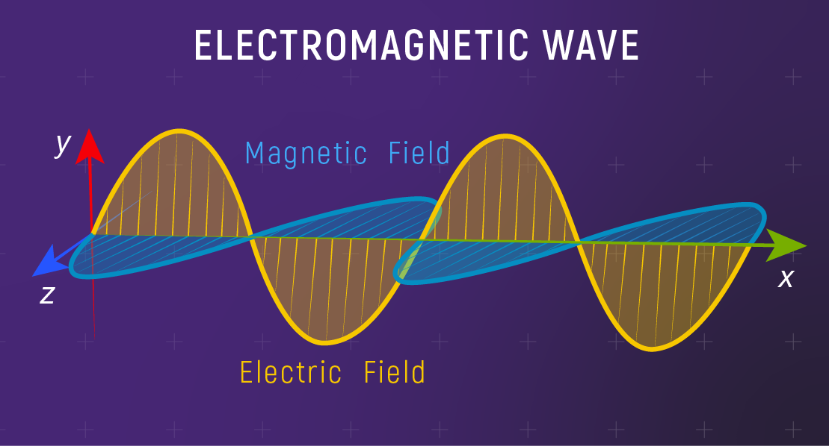
Fundamentals of electromagnetic waves
Electromagnetic (EM) waves are synchronized oscillations of electric and magnetic field. There is a periodic change of electric and magnetic field
How often this periodic change occurs dictates the property of EM waves
Notes:
First, we look at the computational elements, and these consist of a microcontroller or an FPGA. Today, we find that these computational elements consume at least one order of magnitude higher power consumption when compared to the commonly used sensors.
However, we also find that microcontrollers are increasingly becoming energy efficient. We investigate a typical microcontroller that has been used in sensor platforms over the past two decades. We find that energy efficiency has improved by almost two orders of magnitude. Some of the present-generation microcontrollers, such as Ambiq Apollo4 consume just 3 uA/MHz than 330 uA for MSP430 used on platforms such as TelOS B.
If the trend continues, we can expect the microcontrollers to catch up with the sensors and become energy-efficient. This significant improvement is that the digital components are increasing becoming efficient as they follow moore’s law.

Slide 10
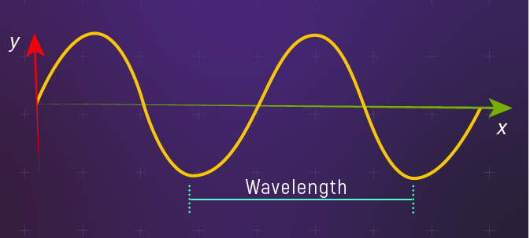
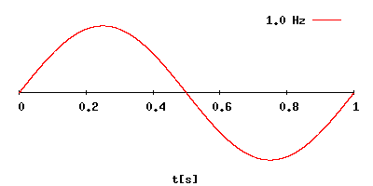
Fundamentals of electromagnetic waves
Electromagnetic (EM) waves are synchronized oscillations of electric and magnetic field. There is a periodic change of electric and magnetic field
How often this periodic change occurs dictates the property of EM waves
Changer period is termed as the frequency. The SI unit for frequency is Hertz (Hz)
1 Hz: one cycle of an electromagnetic wave in a second
Notes:
First, we look at the computational elements, and these consist of a microcontroller or an FPGA. Today, we find that these computational elements consume at least one order of magnitude higher power consumption when compared to the commonly used sensors.
However, we also find that microcontrollers are increasingly becoming energy efficient. We investigate a typical microcontroller that has been used in sensor platforms over the past two decades. We find that energy efficiency has improved by almost two orders of magnitude. Some of the present-generation microcontrollers, such as Ambiq Apollo4 consume just 3 uA/MHz than 330 uA for MSP430 used on platforms such as TelOS B.
If the trend continues, we can expect the microcontrollers to catch up with the sensors and become energy-efficient. This significant improvement is that the digital components are increasing becoming efficient as they follow moore’s law.

Slide 11
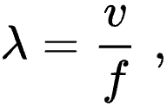
Wavelength of an electromagnetic wave
Wavelength of a sinusoidal waveform travelling at speed (v), frequency (f)
Electromagnetic waves that are travelling in free space, the speed is c or the speed of light. What is speed of light?
Notes:
First, we look at the computational elements, and these consist of a microcontroller or an FPGA. Today, we find that these computational elements consume at least one order of magnitude higher power consumption when compared to the commonly used sensors.
However, we also find that microcontrollers are increasingly becoming energy efficient. We investigate a typical microcontroller that has been used in sensor platforms over the past two decades. We find that energy efficiency has improved by almost two orders of magnitude. Some of the present-generation microcontrollers, such as Ambiq Apollo4 consume just 3 uA/MHz than 330 uA for MSP430 used on platforms such as TelOS B.
If the trend continues, we can expect the microcontrollers to catch up with the sensors and become energy-efficient. This significant improvement is that the digital components are increasing becoming efficient as they follow moore’s law.

Slide 12
Wavelength of an electromagnetic wave
Wavelength of a sinusoidal waveform travelling at speed (v), frequency (f)
Electromagnetic waves that are travelling in free space, the speed is c or the speed of light. What is speed of light? 3×10⁸ m/s
Different color of light, different wavelength!
Notes:
First, we look at the computational elements, and these consist of a microcontroller or an FPGA. Today, we find that these computational elements consume at least one order of magnitude higher power consumption when compared to the commonly used sensors.
However, we also find that microcontrollers are increasingly becoming energy efficient. We investigate a typical microcontroller that has been used in sensor platforms over the past two decades. We find that energy efficiency has improved by almost two orders of magnitude. Some of the present-generation microcontrollers, such as Ambiq Apollo4 consume just 3 uA/MHz than 330 uA for MSP430 used on platforms such as TelOS B.
If the trend continues, we can expect the microcontrollers to catch up with the sensors and become energy-efficient. This significant improvement is that the digital components are increasing becoming efficient as they follow moore’s law.

Slide 13
What does the term radio mean?
Radio technology implies the task of transmission and reception of information using electromagnetic waves of frequency 3 Hz to 300 GHz. Electromagnetic waves at these frequencies are also called radio waves, and the frequency bands are called radio spectrum.
Notes:
First, we look at the computational elements, and these consist of a microcontroller or an FPGA. Today, we find that these computational elements consume at least one order of magnitude higher power consumption when compared to the commonly used sensors.
However, we also find that microcontrollers are increasingly becoming energy efficient. We investigate a typical microcontroller that has been used in sensor platforms over the past two decades. We find that energy efficiency has improved by almost two orders of magnitude. Some of the present-generation microcontrollers, such as Ambiq Apollo4 consume just 3 uA/MHz than 330 uA for MSP430 used on platforms such as TelOS B.
If the trend continues, we can expect the microcontrollers to catch up with the sensors and become energy-efficient. This significant improvement is that the digital components are increasing becoming efficient as they follow moore’s law.

Slide 14


What does the term radio mean?
Radio technology implies the task of transmission and reception of information using electromagnetic waves of frequency 3 Hz to 300 GHz. Electromagnetic waves at these frequencies are also called radio waves, and the frequency bands are called radio spectrum.
What is wavelength for frequency of 3 KHz? (approx.) 100 Kilometer!
Distance between London and Oxford
Notes:
First, we look at the computational elements, and these consist of a microcontroller or an FPGA. Today, we find that these computational elements consume at least one order of magnitude higher power consumption when compared to the commonly used sensors.
However, we also find that microcontrollers are increasingly becoming energy efficient. We investigate a typical microcontroller that has been used in sensor platforms over the past two decades. We find that energy efficiency has improved by almost two orders of magnitude. Some of the present-generation microcontrollers, such as Ambiq Apollo4 consume just 3 uA/MHz than 330 uA for MSP430 used on platforms such as TelOS B.
If the trend continues, we can expect the microcontrollers to catch up with the sensors and become energy-efficient. This significant improvement is that the digital components are increasing becoming efficient as they follow moore’s law.

Slide 15
What are radio transceivers?
Radio transceivers are components that enables the transmission and reception of electromagnetic waves. A key component in wireless device
Antenna
Radio frequency signal
Transmitting
Device
Receiving Device
Notes:
First, we look at the computational elements, and these consist of a microcontroller or an FPGA. Today, we find that these computational elements consume at least one order of magnitude higher power consumption when compared to the commonly used sensors.
However, we also find that microcontrollers are increasingly becoming energy efficient. We investigate a typical microcontroller that has been used in sensor platforms over the past two decades. We find that energy efficiency has improved by almost two orders of magnitude. Some of the present-generation microcontrollers, such as Ambiq Apollo4 consume just 3 uA/MHz than 330 uA for MSP430 used on platforms such as TelOS B.
If the trend continues, we can expect the microcontrollers to catch up with the sensors and become energy-efficient. This significant improvement is that the digital components are increasing becoming efficient as they follow moore’s law.

Slide 16
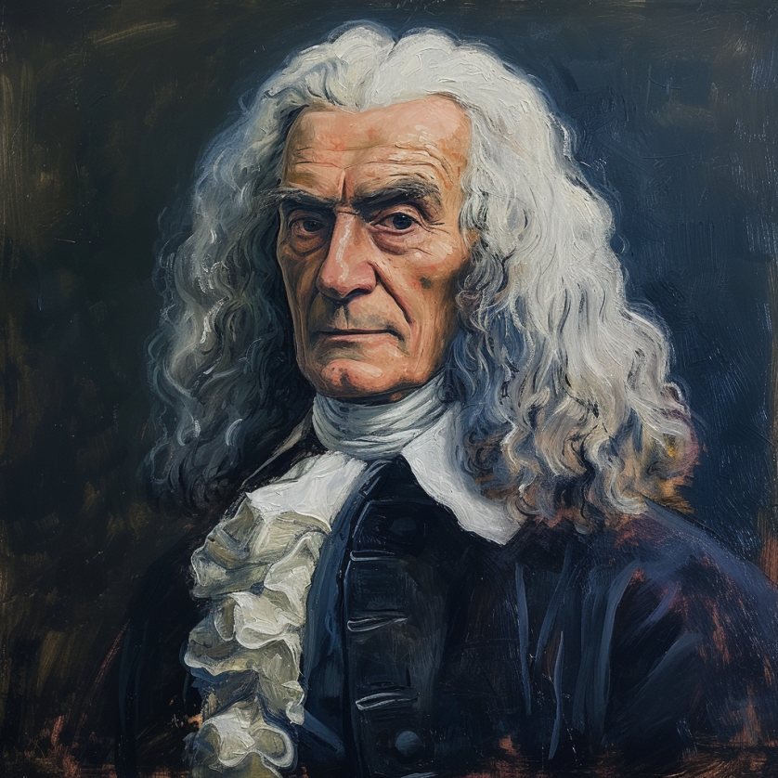
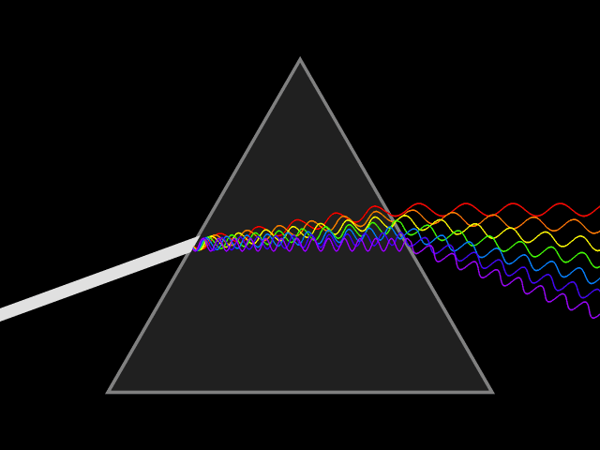
What do you mean by spectrum? Radio spectrum?
In the 17th century, Isaac Newton introduced the concept of the spectrum to the field of physical sciences, specifically in optics. He used this term to describe the array of colors visible when white light passed through a prism and was separated into its constituent hues. Later the term was expanded to include other waves, including radio waves.
Notes:
First, we look at the computational elements, and these consist of a microcontroller or an FPGA. Today, we find that these computational elements consume at least one order of magnitude higher power consumption when compared to the commonly used sensors.
However, we also find that microcontrollers are increasingly becoming energy efficient. We investigate a typical microcontroller that has been used in sensor platforms over the past two decades. We find that energy efficiency has improved by almost two orders of magnitude. Some of the present-generation microcontrollers, such as Ambiq Apollo4 consume just 3 uA/MHz than 330 uA for MSP430 used on platforms such as TelOS B.
If the trend continues, we can expect the microcontrollers to catch up with the sensors and become energy-efficient. This significant improvement is that the digital components are increasing becoming efficient as they follow moore’s law.

Slide 17
How are radio waves characterized?
Radio waves can be characterized based on following parameters:
Strength/Power: energy contained in the radio wave
Frequency: rate of periodic variation between electric and magnetic field
Bandwidth: range of frequencies of radio waves present in the transmission
Polarization: orientation of electric field. May be circular, elliptical or linear
Modulation: variation of waves property to encode information
Notes:
First, we look at the computational elements, and these consist of a microcontroller or an FPGA. Today, we find that these computational elements consume at least one order of magnitude higher power consumption when compared to the commonly used sensors.
However, we also find that microcontrollers are increasingly becoming energy efficient. We investigate a typical microcontroller that has been used in sensor platforms over the past two decades. We find that energy efficiency has improved by almost two orders of magnitude. Some of the present-generation microcontrollers, such as Ambiq Apollo4 consume just 3 uA/MHz than 330 uA for MSP430 used on platforms such as TelOS B.
If the trend continues, we can expect the microcontrollers to catch up with the sensors and become energy-efficient. This significant improvement is that the digital components are increasing becoming efficient as they follow moore’s law.

Slide 18
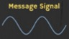
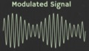
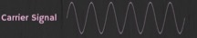
How are radio waves modified to carry information
Encoding information “baseband" in an analog “carrier” signal
Baseband signal often much lower in frequency than the carrier
Frequency of the carrier signal dictates the part of the radio spectrum
Why? baseband signals or information change is at much lower rate
Speech: upto 20 KHz, temperature changes – few Hz
Enables a better usage of the radio spectrum
Enables communication among several devices sharing the spectrum
Modulation
Notes:
First, we look at the computational elements, and these consist of a microcontroller or an FPGA. Today, we find that these computational elements consume at least one order of magnitude higher power consumption when compared to the commonly used sensors.
However, we also find that microcontrollers are increasingly becoming energy efficient. We investigate a typical microcontroller that has been used in sensor platforms over the past two decades. We find that energy efficiency has improved by almost two orders of magnitude. Some of the present-generation microcontrollers, such as Ambiq Apollo4 consume just 3 uA/MHz than 330 uA for MSP430 used on platforms such as TelOS B.
If the trend continues, we can expect the microcontrollers to catch up with the sensors and become energy-efficient. This significant improvement is that the digital components are increasing becoming efficient as they follow moore’s law.

Slide 19
What are different modulation techniques?
Vary frequency, amplitude, phase of carrier signal according message signal
We can also vary them together to support complex modulation schemes
Analog and Digital counterparts of these modulation schemes exist
Modulation
Notes:
First, we look at the computational elements, and these consist of a microcontroller or an FPGA. Today, we find that these computational elements consume at least one order of magnitude higher power consumption when compared to the commonly used sensors.
However, we also find that microcontrollers are increasingly becoming energy efficient. We investigate a typical microcontroller that has been used in sensor platforms over the past two decades. We find that energy efficiency has improved by almost two orders of magnitude. Some of the present-generation microcontrollers, such as Ambiq Apollo4 consume just 3 uA/MHz than 330 uA for MSP430 used on platforms such as TelOS B.
If the trend continues, we can expect the microcontrollers to catch up with the sensors and become energy-efficient. This significant improvement is that the digital components are increasing becoming efficient as they follow moore’s law.

Slide 20
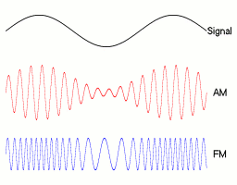
Amplitude modulation: vary amplitude of carrier signal
Change amplitude of a carrier signal according to the message signal
Simplest and the earliest introduced modulation technique
Remains widely used for radio broadcast, also computer communication
Disadvantage: signal prone to interference, less bandwidth efficient
Notes:
First, we look at the computational elements, and these consist of a microcontroller or an FPGA. Today, we find that these computational elements consume at least one order of magnitude higher power consumption when compared to the commonly used sensors.
However, we also find that microcontrollers are increasingly becoming energy efficient. We investigate a typical microcontroller that has been used in sensor platforms over the past two decades. We find that energy efficiency has improved by almost two orders of magnitude. Some of the present-generation microcontrollers, such as Ambiq Apollo4 consume just 3 uA/MHz than 330 uA for MSP430 used on platforms such as TelOS B.
If the trend continues, we can expect the microcontrollers to catch up with the sensors and become energy-efficient. This significant improvement is that the digital components are increasing becoming efficient as they follow moore’s law.

Slide 21
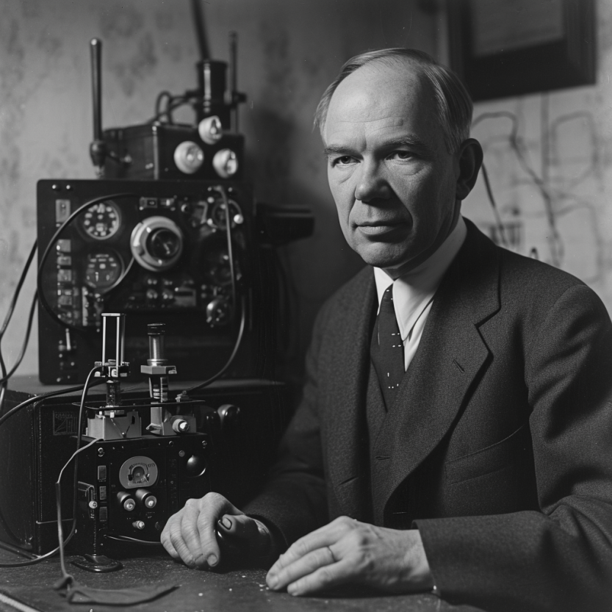
Frequency modulation: vary frequency of carrier signal
Change frequency of a carrier signal according to the message signal
Advantages (over AM): Resilient to interference, spectrum efficiency
Remains widely used for radio broadcast, also computer communication
First demonstrated by Armstrong in 1935!
Notes:
First, we look at the computational elements, and these consist of a microcontroller or an FPGA. Today, we find that these computational elements consume at least one order of magnitude higher power consumption when compared to the commonly used sensors.
However, we also find that microcontrollers are increasingly becoming energy efficient. We investigate a typical microcontroller that has been used in sensor platforms over the past two decades. We find that energy efficiency has improved by almost two orders of magnitude. Some of the present-generation microcontrollers, such as Ambiq Apollo4 consume just 3 uA/MHz than 330 uA for MSP430 used on platforms such as TelOS B.
If the trend continues, we can expect the microcontrollers to catch up with the sensors and become energy-efficient. This significant improvement is that the digital components are increasing becoming efficient as they follow moore’s law.

Slide 22
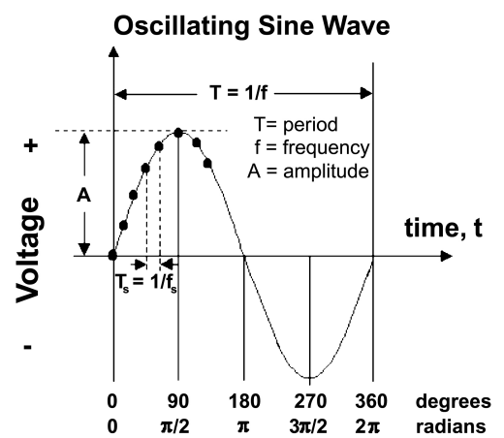
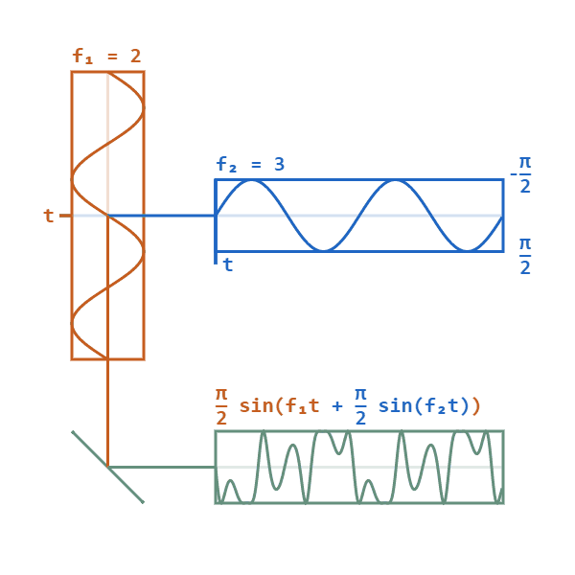
Phase modulation: vary phase of carrier signal
Change phase of a carrier signal according to the message signal
It is an integral part of modern communication standards: WiFi, Television
Advantages (over FM): Better SNR, spectral efficiency
Notes:
First, we look at the computational elements, and these consist of a microcontroller or an FPGA. Today, we find that these computational elements consume at least one order of magnitude higher power consumption when compared to the commonly used sensors.
However, we also find that microcontrollers are increasingly becoming energy efficient. We investigate a typical microcontroller that has been used in sensor platforms over the past two decades. We find that energy efficiency has improved by almost two orders of magnitude. Some of the present-generation microcontrollers, such as Ambiq Apollo4 consume just 3 uA/MHz than 330 uA for MSP430 used on platforms such as TelOS B.
If the trend continues, we can expect the microcontrollers to catch up with the sensors and become energy-efficient. This significant improvement is that the digital components are increasing becoming efficient as they follow moore’s law.

Slide 23
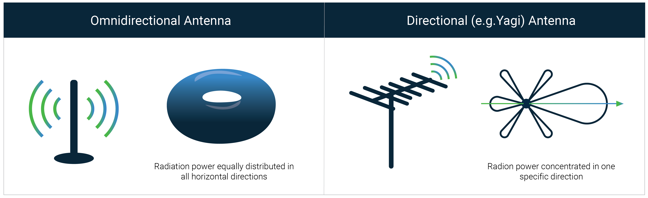
How radio waves radiate out from transceiver
Antenna: An electrical conductor or system of conductors
Transmission: radio frequency electrical energy converted into electromagnetic energy
Reception: the reverse occurs, electromagnetic energy converted into electrical energy
Antennas can be categorized intro directional or omnidirectional
Based on the radiation pattern of the antenna

Slide 24
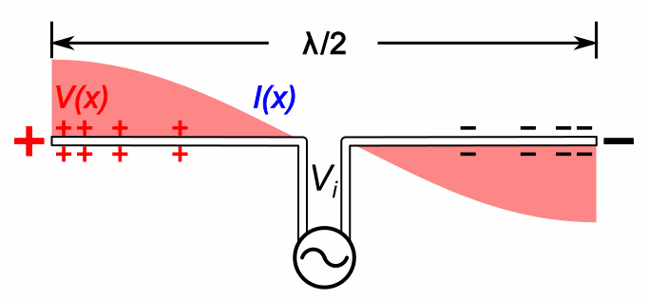
Relationship between antenna size and frequency
Antenna size is inversely proportional to the frequency of radio wave
Higher the frequency, smaller the antenna size
Lower frequency, larger is the antenna size
For example:
Dipole: Length of the conductor is half of the wave length of radio wave
Half-wave dipole: Length of conductor is quarter wavelength of radio wave

Slide 25
Understanding the performance of an antenna
Gain of antenna: It is a dimensionless quantity that measures the ability of an antenna to direct or receive radio waves in a particular direction compared to a reference. It is usually measured in the unit of decibel (dB)
Often measured in reference to hypothetical isotropic antenna (dBi)
Can be measured in reference to a halfwave dipole antenna (dBd)
Antennas are reciprocal in nature. Transmit and receive equally well
Tradeoffs: Higher the gain, more directional is the transmission and reception, and the narrower would be the beam

Slide 26
Understanding the performance of an antenna
Power output, in a particular direction, compared to that produced in any direction by a perfect omni-directional antenna (isotropic antenna)‏
Effective area: related to physical size and shape of antenna
Relationship between antenna gain and effective area
G = antenna gain
A_{e} = effective area
f = carrier frequency
c = speed of light 3 X 10⁸ m/s
Lambda = carrier wavelength

Slide 27


How do radio waves propagate from TX to RX?
Medium and environment has an important role to play in propagation
Radio waves do not propagate well underwater. Submarines uses sound
Environment impacts the radio wave propagation significantly
Reduced communication range
Interference from other devices
Issues with reliability
…… and many more

Slide 28
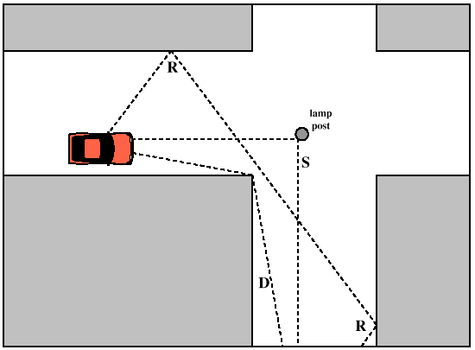
Radio propagation is complex in real-world, especially when obstacles are present
Reflection
e.g. earth surface, buildings
Diffraction
Radio wave bends around the obstacle
Scattering
Obstacles smaller than wavelength of wave (e.g. foliage)
Signal is scattered into several weaker signals

Slide 29
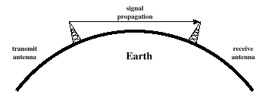
Radio waves propagation in line-of-sight
Transmitting and receiving antennas must be within line of sight
Satellite communication – signal above 30 MHz not reflected by ionosphere
Ground communication – antennas in effective line of site due to refraction

Slide 30


Non-line of sight propagation of radio waves
Transmitter and receiver are not kept in line of sight
Radio waves encounter obstacles, may go through walls, buildings
Much more applicable to read world environment and deployments
Significantly impacts the communication range and reliability

Slide 31
Estimating received signal strength and range: Friis propagation model
f_{c} is the center frequency in Hz
c is speed of light
d is the distance between transmitter and receiver
Alpha is the path loss component
G is antenna gain

Slide 32
Path Loss Exponent
Environment
Path Loss Exponential (α)
Free Space
2
Urban area cellualr radio
2.7 to 3.5
Shadowed urban cellular radio
3 to 5
In building LOS
1.6 to 1.8
Obstructed in building
4 to 6
Obstructed in factory
2 to 3
Rapport, Table 4.2, pp139

Slide 33
Roadmap of the lecture today
General course information and updates
Let us review what we had covered in the last lecture
Radio signal propagation, attenuation and decibel
What are sensors, different type of sensing modality
Acutation and SensorTag Platform
Notes:
Here is the roadmap of the major topics that I am going to cover during the presentation. We have already covered the exponential growth of the internet of things; next, I will talk about the critical energy challenge that can severely hinder this massive growth and preventing us from realising this immense economic value enabled by the IoT.

Slide 34
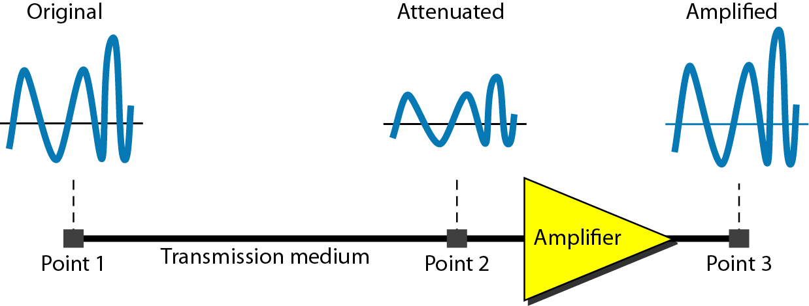
Attenuation and Gain: Decibel (dB) unit
Attenuation: Means loss of energy
When signal traverses through a medium, it loses energy.
Gain: Means increase in energy
Often devices such as amplifiers are employed to improve the signal strength
Commonly, we use decibel to calculate gain or loss/attenuation of signal
dB = 10log₁₀P₂/P₁
P₁ - input signal, P₂ - output signal

Slide 35
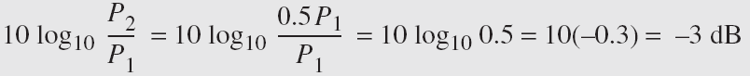
Operations in decibel (dB) examples
Suppose a signal travels through a transmission medium and its power decreases to one-half of its original value, meaning that P2 is equal to (1/2)P1. In this scenario, the attenuation, or loss of power, can be determined using the following formula:
Thus, loss of 3 dB, is equivalent to losing half of the signal power

Slide 36
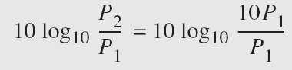
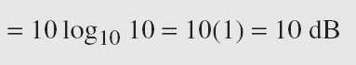
Operations in decibel (dB) examples
A signal passes through an amplifier, resulting in a tenfold increase in power, expressed as P2 = 10P1. The amplification, also known as the power gain, can be calculated as:
One reason engineers use decibels to measure changes in signal strength is that decibel values can be easily added or subtracted
L1 = 3b, L2 = 7 db, Combined loss: 10 dB

Slide 37
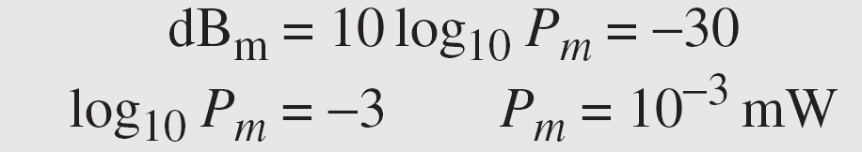
Unit of power of a signal: dBm (decibel milliwatt)
Decibel (dBm) is a measure of signal power, calculated as 10 log10 (Pm) where Pm is power in milliwatts
Example: Calculate the power of a signal with dB_{m} = −30
Caution: We can add/subtract dB and dB term together, but we cannot perform these operations on dB and dBm term and vice versa

Slide 38
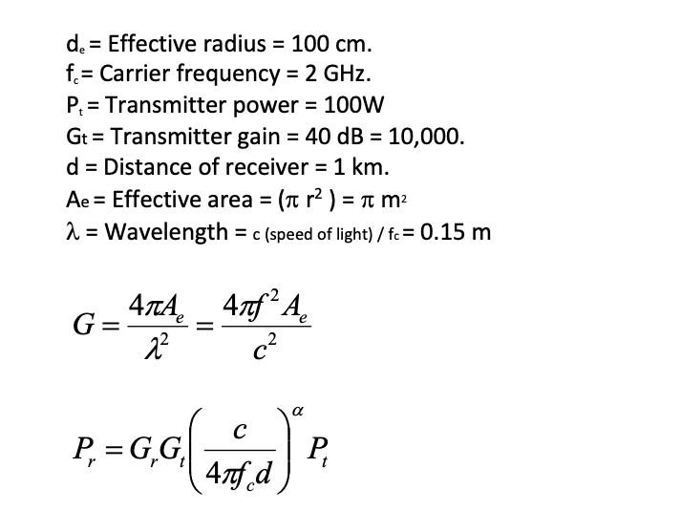
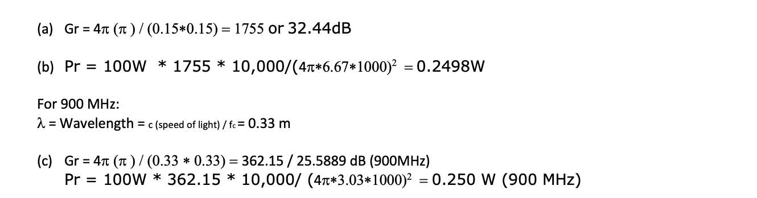
Example: Range and antenna gain estimation
Question: A wireless receiver with an effective radius of 100cm is receiving signals at 2 GHz from a transmitter that transmits at a power of 100W and a gain of 40dB (or 10,000). Assume path loss exponent is 2.
What is the gain of the receiver antenna?
What is the received power if the receiver is 1km away from the transmitter?
If the receiver is receiving signals at 900 MHz frequency (instead of 2GHz), please calculate (a) and (b) again?
What do you notice and why?

Slide 39
Example: Range and antenna gain estimation
The antenna gain decreases at lower frequencies (if the remaining factors are kept constant). Second, despite lower antenna gain due to higher frequencies, better propagation characteristics mean that the received signal power remains similar to one we had calculated at a higher frequency. Lower frequencies have better propagation characteristics.

Slide 40
Roadmap of the lecture today
General course information and updates
Let us review what we had covered in the last lecture
Radio signal propagation, attenuation and decibel
What are sensors, different type of sensing modality
Acutation and SensorTag Platform
Notes:
Here is the roadmap of the major topics that I am going to cover during the presentation. We have already covered the exponential growth of the internet of things; next, I will talk about the critical energy challenge that can severely hinder this massive growth and preventing us from realising this immense economic value enabled by the IoT.

Slide 41
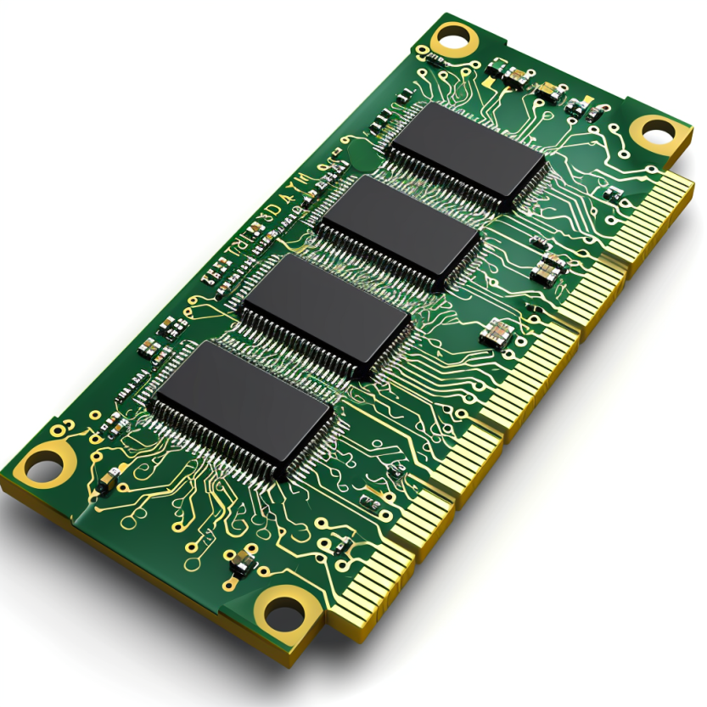
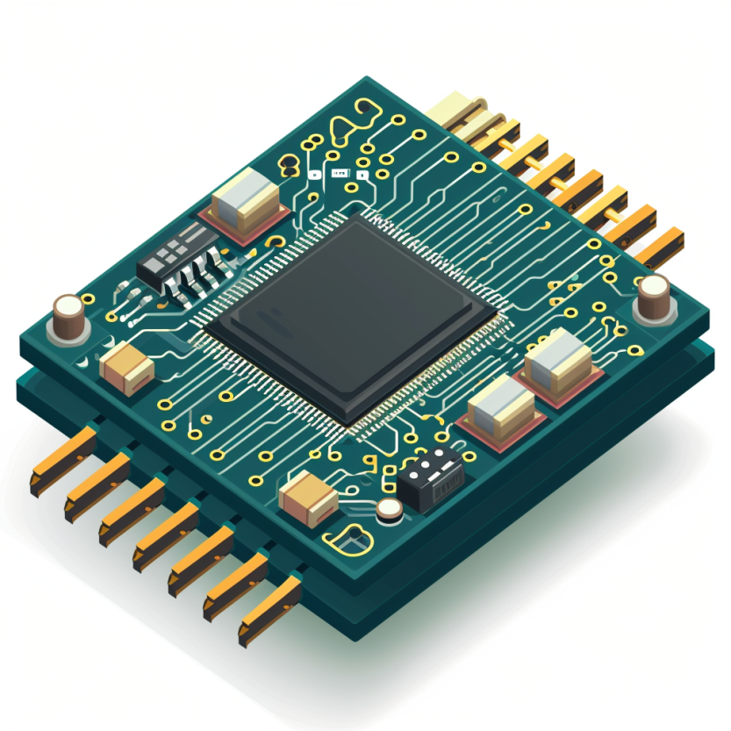

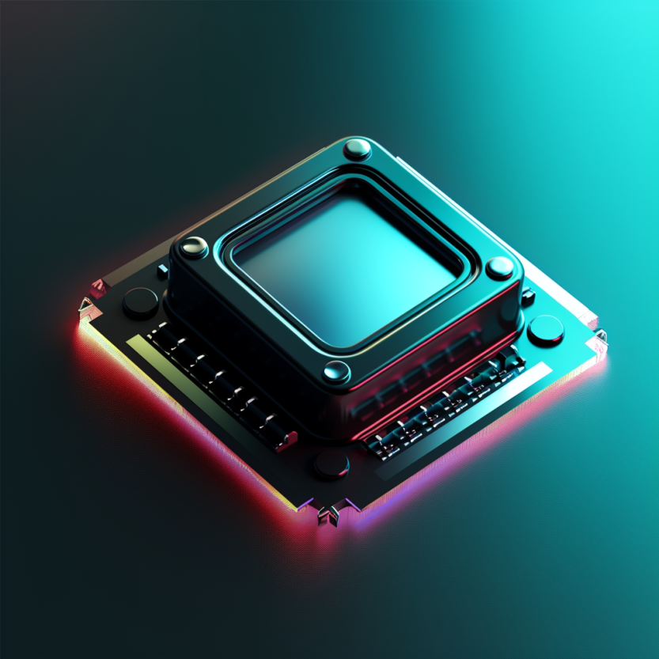


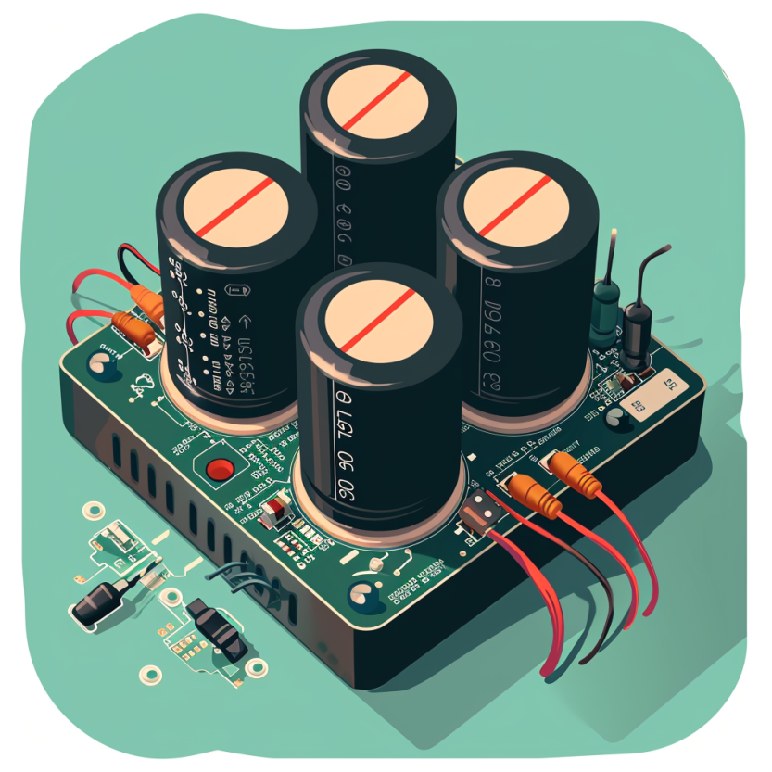
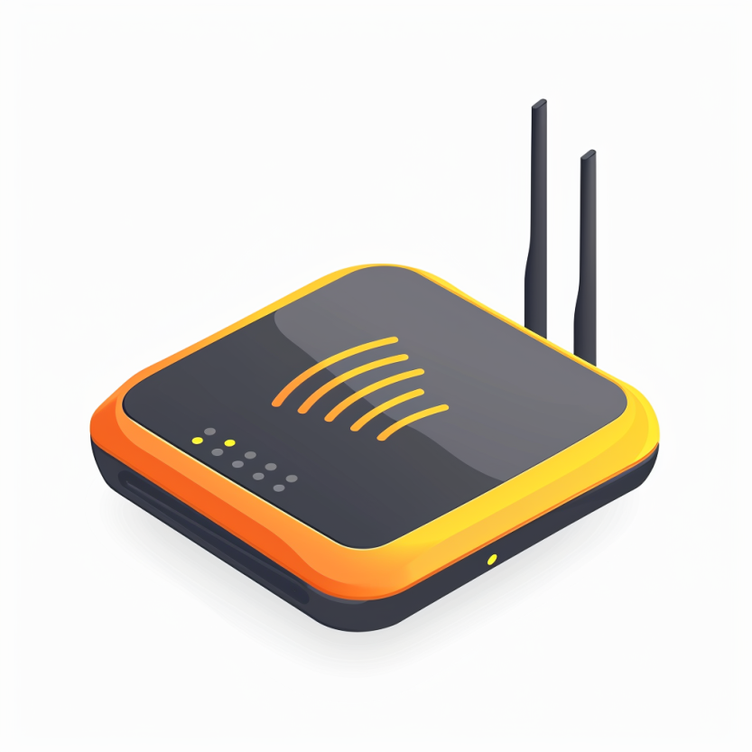

Four main tasks performed by an embedded device
Computation and Storage
Sensing and Actuation
Power
Management
Wireless Networking
Notes:
First, we look at the computational elements, and these consist of a microcontroller or an FPGA. Today, we find that these computational elements consume at least one order of magnitude higher power consumption when compared to the commonly used sensors.
However, we also find that microcontrollers are increasingly becoming energy efficient. We investigate a typical microcontroller that has been used in sensor platforms over the past two decades. We find that energy efficiency has improved by almost two orders of magnitude. Some of the present-generation microcontrollers, such as Ambiq Apollo4 consume just 3 uA/MHz than 330 uA for MSP430 used on platforms such as TelOS B.
If the trend continues, we can expect the microcontrollers to catch up with the sensors and become energy-efficient. This significant improvement is that the digital components are increasing becoming efficient as they follow moore’s law.

Slide 42
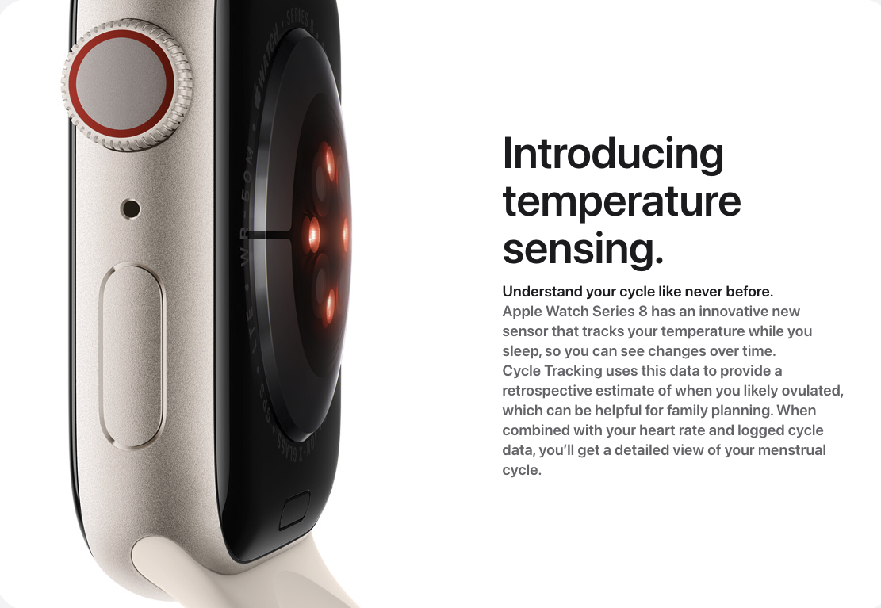
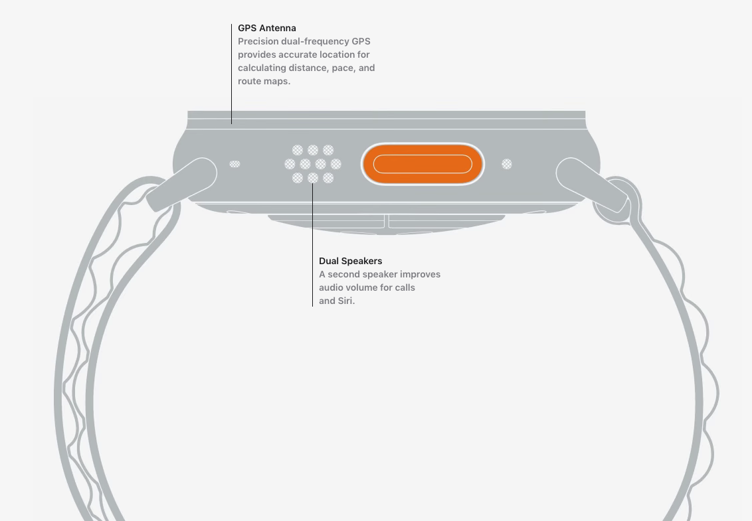
Sensors and actuators are an integral part of most consumer electronic devices
Essential part of almost all consumer electronic devices
They are an Interface of electronic devices with the physical world
Courtesy: Apple
Notes:
First, we look at the computational elements, and these consist of a microcontroller or an FPGA. Today, we find that these computational elements consume at least one order of magnitude higher power consumption when compared to the commonly used sensors.
However, we also find that microcontrollers are increasingly becoming energy efficient. We investigate a typical microcontroller that has been used in sensor platforms over the past two decades. We find that energy efficiency has improved by almost two orders of magnitude. Some of the present-generation microcontrollers, such as Ambiq Apollo4 consume just 3 uA/MHz than 330 uA for MSP430 used on platforms such as TelOS B.
If the trend continues, we can expect the microcontrollers to catch up with the sensors and become energy-efficient. This significant improvement is that the digital components are increasing becoming efficient as they follow moore’s law.

Slide 43
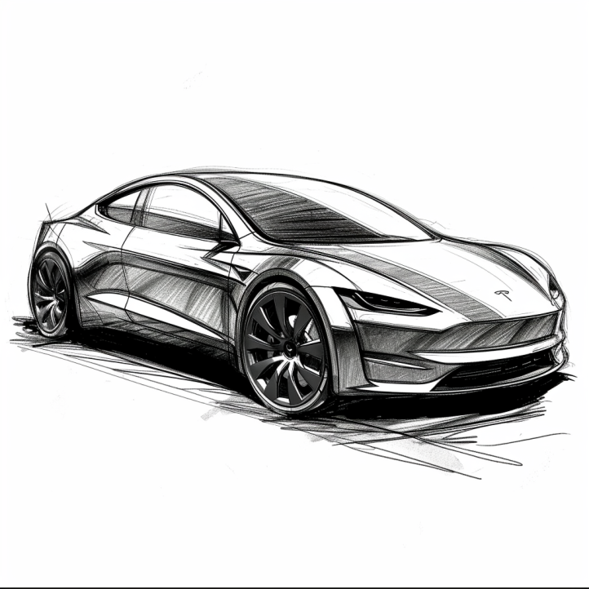
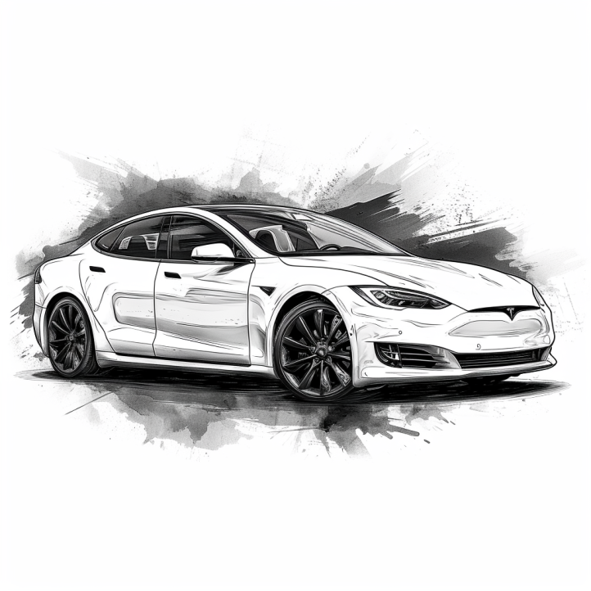
Cars are all software and sensors
Electric cars have numerous sensors and microcontrollers
Various sensors that are used in cars include:
Tracking location: GPS (global positioning system)
Distance measurement: Ultrasonic sensors
Terrain mapping: Lidar (light detection and ranging)
Proximity sensing: radar
Various forms of cameras
Motion sensor: accelerometers
…. And many more
Notes:
First, we look at the computational elements, and these consist of a microcontroller or an FPGA. Today, we find that these computational elements consume at least one order of magnitude higher power consumption when compared to the commonly used sensors.
However, we also find that microcontrollers are increasingly becoming energy efficient. We investigate a typical microcontroller that has been used in sensor platforms over the past two decades. We find that energy efficiency has improved by almost two orders of magnitude. Some of the present-generation microcontrollers, such as Ambiq Apollo4 consume just 3 uA/MHz than 330 uA for MSP430 used on platforms such as TelOS B.
If the trend continues, we can expect the microcontrollers to catch up with the sensors and become energy-efficient. This significant improvement is that the digital components are increasing becoming efficient as they follow moore’s law.

Slide 44
So, what are sensors ?
They are an eyes and ears for an embedded device. They sense environment and help to understand the physical world. Sensor is an electronic component that measures a physical phenomenon.
What are the phenomenon that you would like to sense and measure?
Temperature
Humidity
Acoustic
Vital signs
…….
Choice of sensor depends on the target embedded application
Notes:
First, we look at the computational elements, and these consist of a microcontroller or an FPGA. Today, we find that these computational elements consume at least one order of magnitude higher power consumption when compared to the commonly used sensors.
However, we also find that microcontrollers are increasingly becoming energy efficient. We investigate a typical microcontroller that has been used in sensor platforms over the past two decades. We find that energy efficiency has improved by almost two orders of magnitude. Some of the present-generation microcontrollers, such as Ambiq Apollo4 consume just 3 uA/MHz than 330 uA for MSP430 used on platforms such as TelOS B.
If the trend continues, we can expect the microcontrollers to catch up with the sensors and become energy-efficient. This significant improvement is that the digital components are increasing becoming efficient as they follow moore’s law.

Slide 45
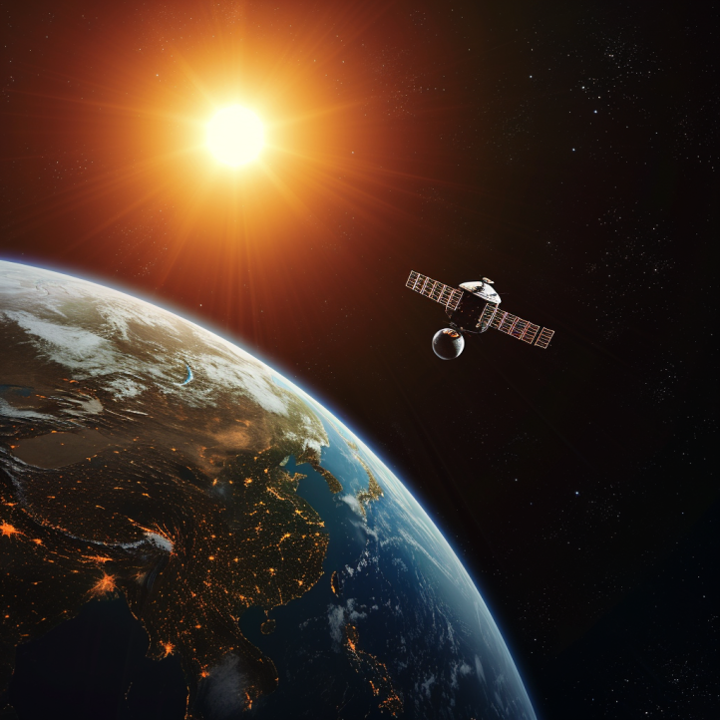
Different forms of sensing: Active vs Passive
Passive Sensing
Active Sensing

Slide 46
Different forms of sensing: Active vs Passive
Passive Sensing
Active Sensing
When we talk about embedded systems we focus on passive sensing. As It is much cheaper and at a lower energy consumption

Slide 47
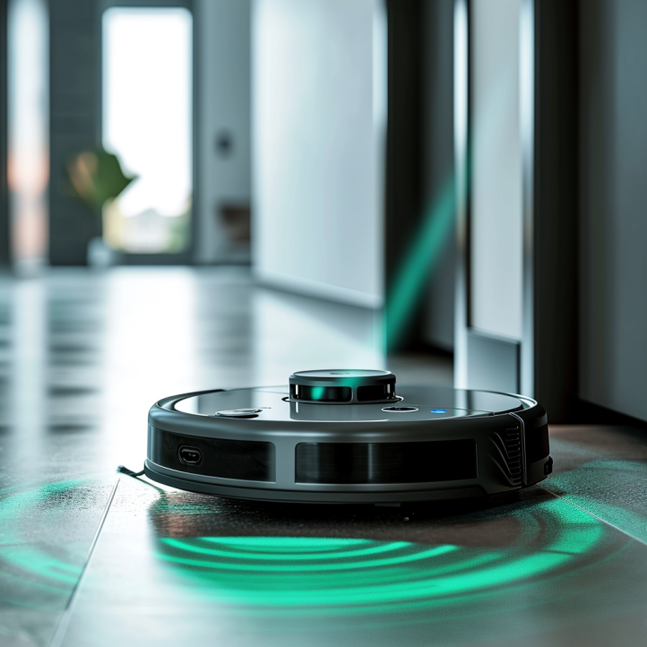
Identify passive/active sensing from applications?
Vacuum cleaners: Distance measurement using ultrasound and Lidar

Slide 48
Identify passive/active sensing from applications?
Vacuum cleaners: Distance measurement using ultrasound and Lidar
Active: Transmit acoustic signal (ultrasound) or laser (Lidar)

Slide 49

Identify passive/active sensing from applications?
Taking photographs under camera flash

Slide 50
Identify passive/active sensing from applications?
Taking photographs under camera flash: active sensing

Slide 51
Identify passive/active sensing from applications?
Taking photographs without camera flash: passive sensing

Slide 52
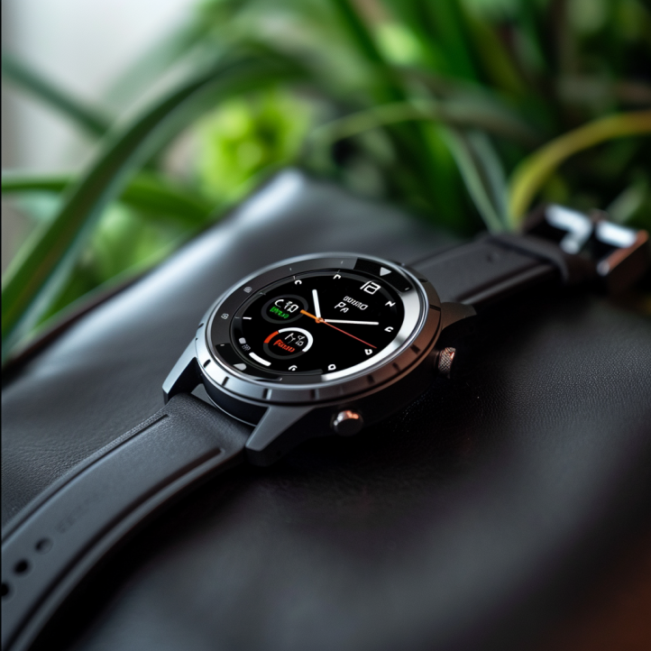
Identify passive/active sensing from applications?
Body temperature sensing on a smart watch?

Slide 53
Identify passive/active sensing from applications?
Body temperature sensing on a smartwatch? Passive sensing

Slide 54
Digital microcontrollers, analog world, and sensors
Microcontrollers: Digital component designed to process digital signals. They interpret commands from the software programmed into their memory.
Analog vs. Digital: The physical world is inherently analog, meaning it varies continuously. A common example of an analog phenomenon is the fluctuation of temperature or humidity.
Sensors are devices that monitor physical phenomena and convert them into electrical signals. These electrical signals can then be processed by microcontrollers to support an embedded application

Slide 55
Sensors transform phenomenon into electrical signals
How sensors convert physical phenomena into electrical signals, we refer to Ohm's Law, which states that Voltage (V) equals Current (I) times Resistance (R)
V (Voltage) = I (Current) X R (Resistance)
By altering one of the variables in Ohm’s law —Voltage (V), Current (I), or Resistance (R)—in response to changes in the phenomenon, a sensor generates an analog electrical signal that corresponds to that phenomenon.

Slide 56
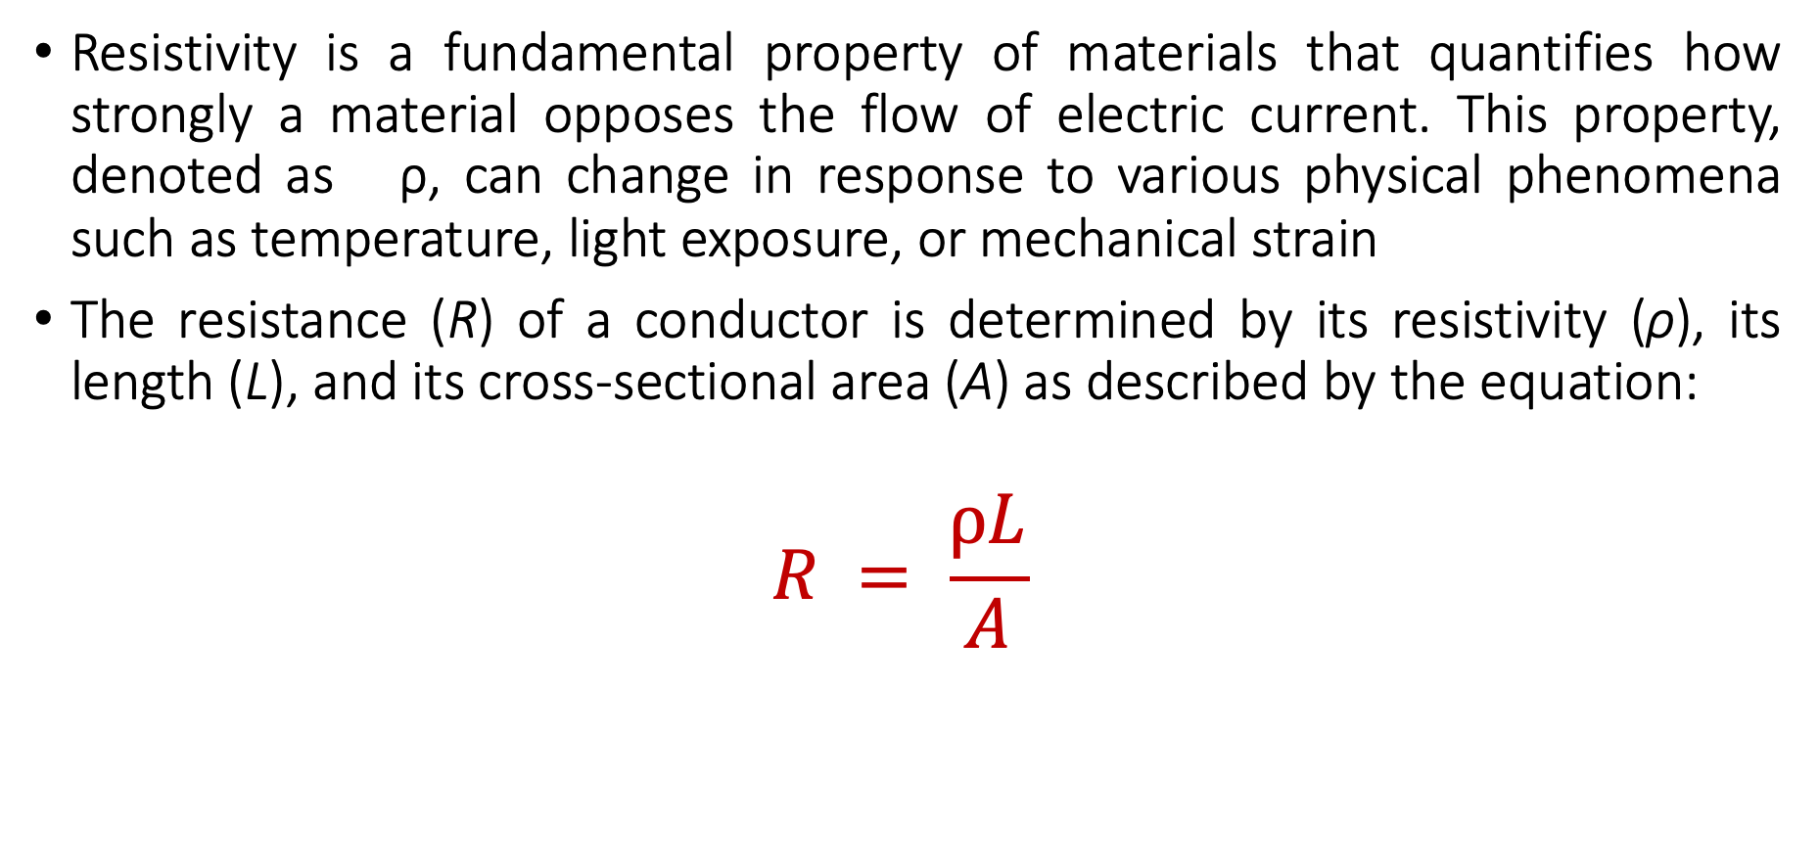
Material Resistivity and its Role in Sensing Phenomena
Resistivity is a fundamental property of materials that quantifies how strongly a material opposes the flow of electric current. This property, denoted as ρ, can change in response to various physical phenomena such as temperature, light exposure, or mechanical strain
The resistance (R) of a conductor is determined by its resistivity (ρ), its length (L), and its cross-sectional area (A) as described by the equation:
$$R = \frac{ρL}{A}$$

Slide 57
Material Resistivity and its Role in Sensing Phenomena
Resistivity is a fundamental property of materials that quantifies how strongly a material opposes the flow of electric current. This property, denoted as ρ, can change in response to various physical phenomena such as temperature, light exposure, or mechanical strain
The resistance (R) of a conductor is determined by its resistivity (ρ), its length (L), and its cross-sectional area (A) as described by the equation:
$$R = \frac{ρL}{A}$$

Slide 58
Material Resistivity and its Role in Sensing Phenomena
Resistivity (ρ): Materials with higher resistivity create more resistance for the same length and area. Resistivity is sensitive to physical conditions;
Temperature: Many conductors have higher resistivity at higher temperatures.
Light: Some materials (like photoresistors) change their resistivity exposed to light.
Strain: Materials known as strain gauges increase in resistivity when stretched.

Slide 59
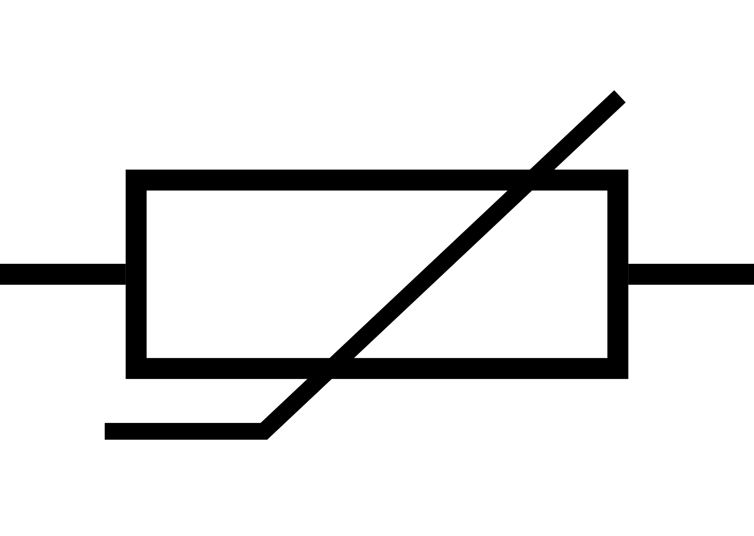
Temperature sensing using resistivity changes
Thermistor is a sensor which varies in resistance based on temperature
Advantages: They are cheap and easy to use. Low cost
Disadvantages: They have a non-linear transfer function

Slide 60
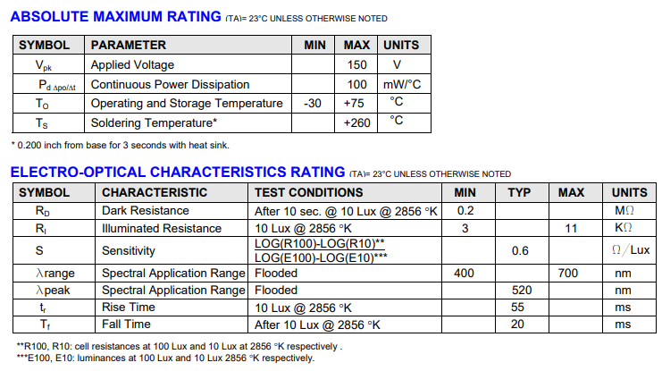
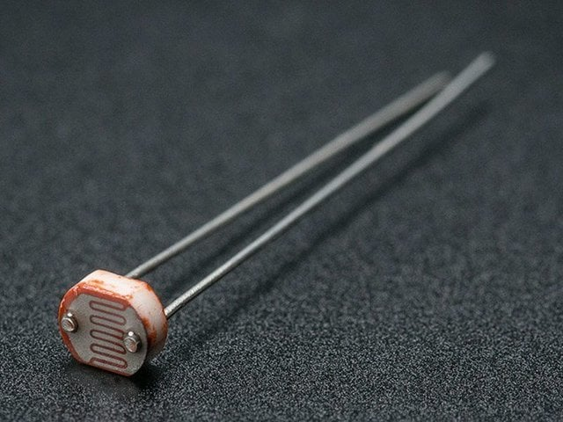
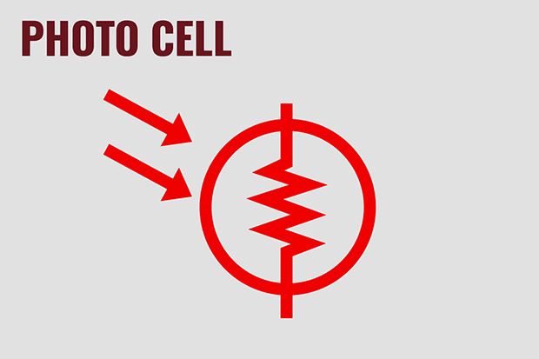
Light sensing using resistive changes
Photocell changes resistance with light (non-linear)
Example:
10 kΩ when dark
1 kΩ when light

Slide 61
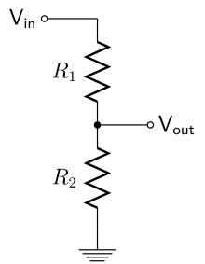
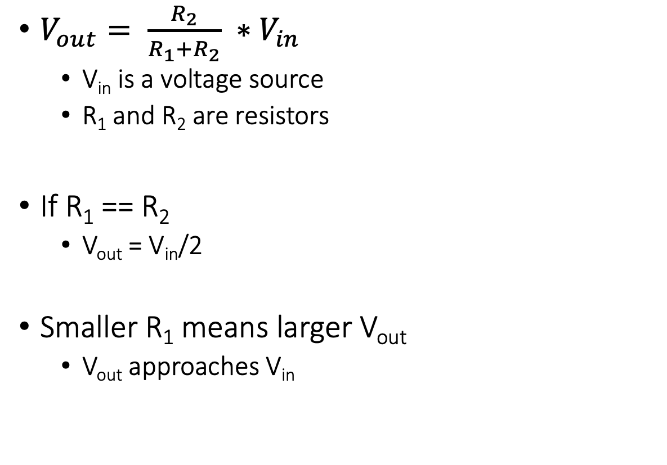
Let us go back to electronics basics: voltage dividers
$V_{out}= \frac{R_{2}}{R_{1}+R_{2}} ∗V_{in}$
V_{in} is a voltage source
R₁ and R₂ are resistors
If R₁ == R₂
V_{out} = V_{in}/2
Smaller R₁ means larger V_{out}
V_{out} approaches V_{in}

Slide 62
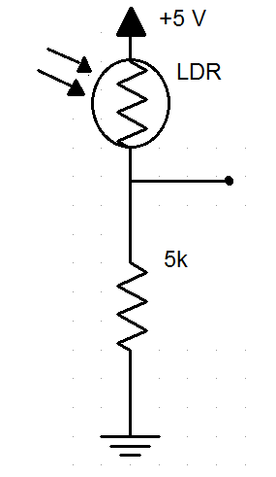
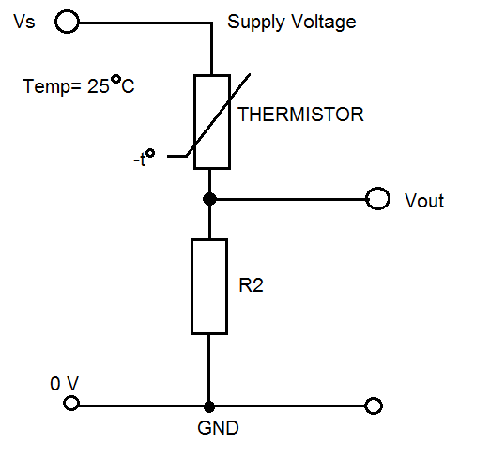
How do we measure a resistive sensor?
Place in series with resistor
Between VCC and ground
Measure voltage between the two relative to ground
Forms a “voltage divider”

Slide 63
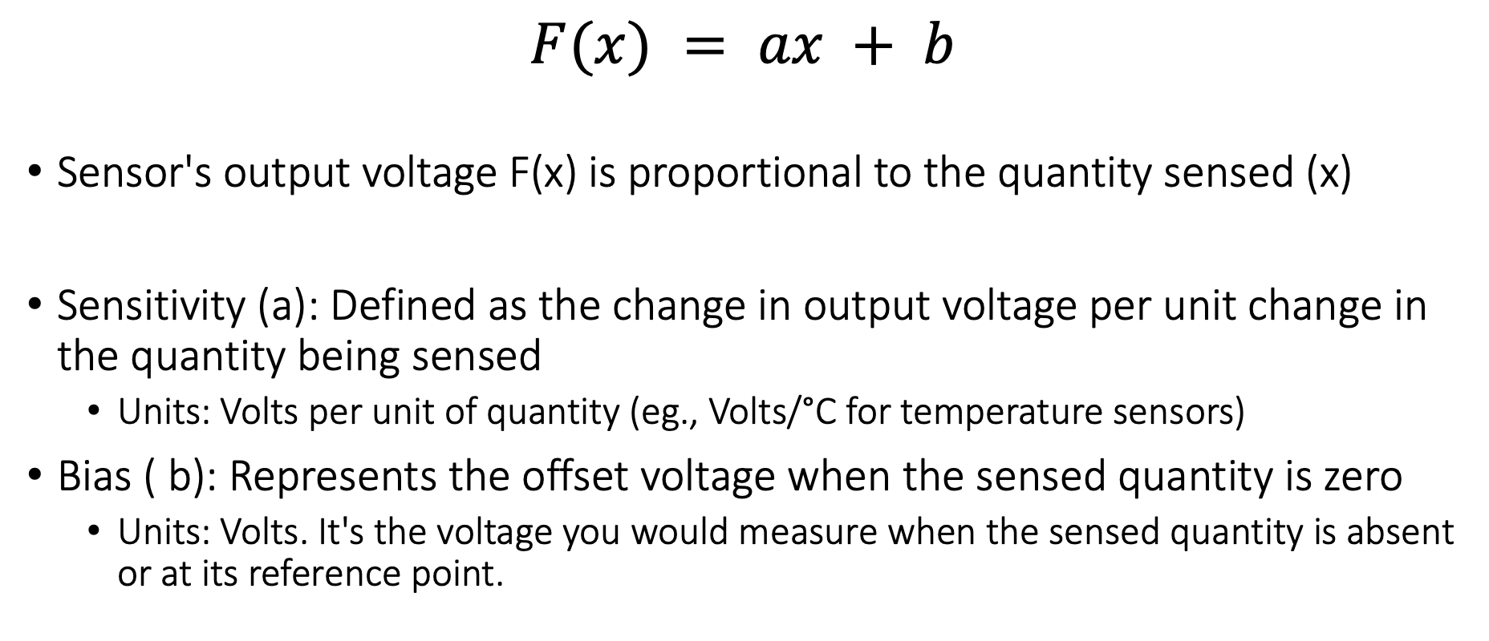
Linear Relationship in Sensing Applications
$$F(x) = ax + b$$
Sensor's output voltage F(x) is proportional to the quantity sensed (x)
Sensitivity (a): Defined as the change in output voltage per unit change in the quantity being sensed
Units: Volts per unit of quantity (eg., Volts/°C for temperature sensors)
Bias ( b): Represents the offset voltage when the sensed quantity is zero
Units: Volts. It's the voltage you would measure when the sensed quantity is absent or at its reference point.

Slide 64
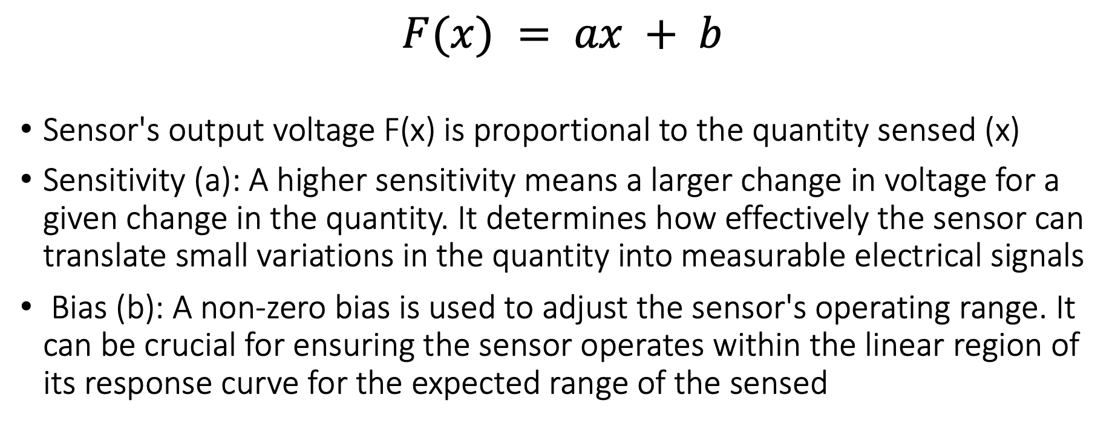
Linear Relationship in Sensing Applications
$$F(x) = ax + b$$
Sensor's output voltage F(x) is proportional to the quantity sensed (x)
Sensitivity (a): A higher sensitivity means a larger change in voltage for a given change in the quantity. It determines how effectively the sensor can translate small variations in the quantity into measurable electrical signals
Bias (b): A non-zero bias is used to adjust the sensor's operating range. It can be crucial for ensuring the sensor operates within the linear region of its response curve for the expected range of the sensed

Slide 65
Taking a step back: Microcontrollers are digital
Up to this point, we have talked about translating physical phenomenon to analog electrical signal changes
How do we convert the analog signal into digital?
Do we need to do any processing before the conversion operation?
Notes:
Why do the IoT platforms suffer from this energy challenge? To understand this, we investigate the architecture of the IoT device. We show this architecture in the figure on the slide. It consists of a series of stages that enable us to sense physical phenomena, process and transmit the sensor information through a transceiver such as ZigBee/BLE/LoRa.
This architecture has remained unchanged over the past two decades. We find that during this time, sensors have become exceeding efficient. Today, we find sensors such as an accelerometer or a temperature sensor consumes just a few tens of microwatts of power consumption. However, we find that rest of the architecture components that are shown in red colour remain significantly energy expensive. To understand the reason for this significant energy asymmetry, we look at the following slide.

Slide 66

Taking a step back: Microcontrollers are digital
Up to this point, we have talked about translating physical phenomenon to analog electrical signal changes
How do we convert the analog signal into digital?
Do we need to do any processing before the conversion operation?
Conventional and widely used architecture of embedded wireless platform
Notes:
Why do the IoT platforms suffer from this energy challenge? To understand this, we investigate the architecture of the IoT device. We show this architecture in the figure on the slide. It consists of a series of stages that enable us to sense physical phenomena, process and transmit the sensor information through a transceiver such as ZigBee/BLE/LoRa.
This architecture has remained unchanged over the past two decades. We find that during this time, sensors have become exceeding efficient. Today, we find sensors such as an accelerometer or a temperature sensor consumes just a few tens of microwatts of power consumption. However, we find that rest of the architecture components that are shown in red colour remain significantly energy expensive. To understand the reason for this significant energy asymmetry, we look at the following slide.

Slide 67
ADC: Bridging the analog and digital worlds
ADCs convert analog signals, which have a continuous range of values, into digital signals, which have discrete numerical representations. This is essential for digital devices to process real-world analog inputs
What are the various parameters of the ADC?
Resolution: Determined by the number of bits the ADC uses to represent the analog value. More bits mean higher resolution and finer granularity in the output
Sampling Rate: The frequency at which the ADC samples the analog signal. Higher sampling rates can capture more detail and are necessary to comply with the Nyquist theorem. It also means higher power consumption
Accuracy: The closeness of the ADC's output to the true input value. It includes factors such as linearity, noise, and error rate
Notes:
Why do the IoT platforms suffer from this energy challenge? To understand this, we investigate the architecture of the IoT device. We show this architecture in the figure on the slide. It consists of a series of stages that enable us to sense physical phenomena, process and transmit the sensor information through a transceiver such as ZigBee/BLE/LoRa.
This architecture has remained unchanged over the past two decades. We find that during this time, sensors have become exceeding efficient. Today, we find sensors such as an accelerometer or a temperature sensor consumes just a few tens of microwatts of power consumption. However, we find that rest of the architecture components that are shown in red colour remain significantly energy expensive. To understand the reason for this significant energy asymmetry, we look at the following slide.

Slide 68

Beyond resistive changes sensing: Potential
Thermocouple generates a voltage based on temperature
This principal is also used to enable harvesting energy from heat energy

Slide 69

Generating voltage via piezoelectric effect
Compression of the material generates a voltage
Various sources of compression:
Air Pressure
Acceleration
Strain

Slide 70


Beyond resistive changes sensing: Potential
Generate a change in voltage that changes based on force

Slide 71


Motion sensing: accelerometers
Accelerometers usually measure in g’s
Where 1 g equals acceleration due to Earth gravity
Determining distance from acceleration is possible
But messy. Error is squared when integrating
Needs careful filtering and is only accurate over short periods
Often fills in gaps between GPS samples (or other localization systems)
Accelerometers also work as tilt sensors
Constantly sensing pull of gravity
$A[x] = 1 g ∗ sin⁡(θ)$

Slide 72
Motion sensing: Inertial measurement unit (IMU)
IMUs (a.k.a 9 degree-of-freedom, 9DOF) track motion of a device
Acceleration (X, Y, Z axes)
Rotation (X, Y, Z axes)
Magnetism (X, Y, Z axes)
Sometimes 6DOF with Acceleration + one of the others
Intelligent sensing: combines multiple sensors, ADCs, and computation with a wired interface
9 analog inputs would otherwise be too many
Can be used to track motion, determine transportation method
Smartphones, Robotics, etc.

Slide 73

Motion sensing: Inertial measurement unit (IMU)
Courtesy: Apple

Slide 74

Microelectromechanical Systems (MEMS)
Same sensing concept, but within an IC and 1 to 100 micrometers in size

Slide 75

Beyond resistive changes sensing: Deformations
Heat bends a strip of two different metals. This switches circuit on/off based on the temperature applied to the bimetallic strip
Application: Fridge! Older models

Slide 76


Other sensors: magnetic field (magnetometer)
Measures the magnetic field. Usually used in devices as a compass
Detect Earth’s magnetic field orientation
Satellites also often use magnetometers for localization
Courtesy: Adafruit

Slide 77



Even more types of sensors
Environment: Pressure, Humidity, Air Velocity, Air Quality
Rotation: Gyroscope
Distance: Ultrasonic, Lidar, or Radar
Biometric: Pulse Oximeter, Heart Rate
Agricultural: Soil moisture

Slide 78


Active sensing: Ultrasound sensor
Emits high frequency sound waves from sensor which bounces from objects that are present in the environment
Estimates distance, proximity by measuring time taken for sounds waves to bounce back and propagate back to the ultrasound device
Power consuming, though can be used on IoT devices
Common application: Robotics, obstacle detection, water level sensing

Slide 79



Passive Infrared (PIR) sensor
Detect movement in the environment
By detecting change in IR levels
Often come with plastic lens cover to improve field of view and range

Slide 80



We use PIR sensors in our day-to-day life

Slide 81

Let’s look at some commonly used IoT devices
Notes:
Backscatter communication actually help us overcome this limitation

Slide 82


What’s inside Apple AirTag
Nordic Semiconductor nRF52832 Bluetooth low-energy SoC w/NFC controller
Notes:
Backscatter communication actually help us overcome this limitation

Slide 83

What’s inside Apple AirTag
Accelerometer: Bosch Sensortec BMA28x 3-axis accelerometer
SoC/Microcontroller: Nordic Semiconductor nRF52832 Bluetooth low-energy SoC w/NFC controller
Actuator: Speaker
And many other componets….
Notes:
Backscatter communication actually help us overcome this limitation

Slide 84

Let’s look at some commonly used IoT devices
Notes:
Backscatter communication actually help us overcome this limitation

Slide 85


Let’s look at some commonly used IoT devices
MediaTek MT3333 GPS SoC
Bosch Sensortec BHI160 Accelerometer/Gyroscope w/ Sensor Hub
STMicroelectronics LIS2DW12 MEMS 3-Axis Accelerometer
Fitbit FBT18SW ARM application processor
Notes:
Backscatter communication actually help us overcome this limitation

Slide 86

Let’s look at some commonly used IoT devices
Notes:
Backscatter communication actually help us overcome this limitation

Slide 87


Let’s look at some commonly used IoT devices
Actuator, very important: 85 dB horn for alarm
Freescale SCK60DN512VLL10 custom Kinetis K60 low-power 100 MHz MCU (Cortex based)
Silicon Labs EM357 Ember Zigbee SoC
Murata Type ZX 2.4 GHz Wi-Fi 802.11b/g/n module (with Broadcom BCM43362 chipset)
Notes:
Backscatter communication actually help us overcome this limitation

Slide 88

TraceTogether Token
Notes:
Backscatter communication actually help us overcome this limitation

Slide 89
Roadmap of the lecture today
General course information and updates
Let us review what we had covered in the last lecture
Radio signal propagation, attenuation and decibel
What are sensors, different type of sensing modality
Actuation and SensorTag Platform
Notes:
Here is the roadmap of the major topics that I am going to cover during the presentation. We have already covered the exponential growth of the internet of things; next, I will talk about the critical energy challenge that can severely hinder this massive growth and preventing us from realising this immense economic value enabled by the IoT.

Slide 90

What are actuators?
Actuator is an electronic component that modifies a physical quantity
Light/LED
Motor
Speaker
…….
Notes:
First, we look at the computational elements, and these consist of a microcontroller or an FPGA. Today, we find that these computational elements consume at least one order of magnitude higher power consumption when compared to the commonly used sensors.
However, we also find that microcontrollers are increasingly becoming energy efficient. We investigate a typical microcontroller that has been used in sensor platforms over the past two decades. We find that energy efficiency has improved by almost two orders of magnitude. Some of the present-generation microcontrollers, such as Ambiq Apollo4 consume just 3 uA/MHz than 330 uA for MSP430 used on platforms such as TelOS B.
If the trend continues, we can expect the microcontrollers to catch up with the sensors and become energy-efficient. This significant improvement is that the digital components are increasing becoming efficient as they follow moore’s law.

Slide 91


Light emitting diodes (LEDs)
Directional component: only allows current to flow one way
Shorter side is the negative one
i.e. where current flows to
Larger metal component
inside of case or case flat spot is cathode or
negative (-) lead
Shorter wire is cathode or
negative (-) lead
Negative ( - ) lead
Schematic Symbol
Notes:
Light Emitting Diodes (LEDs) are vital actuators for embedded and Internet of Things (IoT) devices. They provide a visual indication of the device's state and can also be used for debugging purposes. LEDs are directional components that allow current to flow in one direction only.
Typically, the cathode, where the current flows, is the shorter side of the LED. LEDs are an effective way to indicate the status of a device and provide feedback during the development and testing phase.
They are also commonly used in consumer electronics and lighting applications.

Slide 92

RGB LEDs
Three different colors of LED in a single large diffuser
Short leads are negative ends
One for each color
Long lead is common power
Common anode
Combinations of LEDs give other colors
Cyan, Yellow, Violet, White
https://cdn-shop.adafruit.com/datasheets/FLR-100WAS-RGB.pdf
Notes:
A unique variant of LEDs is the RGB (Red, Green, Blue) LED, which allows for the emission of three different colors. The short leads are the negative end, and each color has its own separate wire. By combining signals on multiple wires, a range of colors can be produced. RGB LEDs provide a versatile and efficient solution for adding color to embedded and IoT devices, as well as for lighting applications. By controlling the intensity of each color, a wide range of hues and shades can be generated, making RGB LEDs ideal for applications where dynamic color changes are desired.

Slide 93

Actuation is energy expensive (wrt sensing)
Notes:
First, we look at the computational elements, and these consist of a microcontroller or an FPGA. Today, we find that these computational elements consume at least one order of magnitude higher power consumption when compared to the commonly used sensors.
However, we also find that microcontrollers are increasingly becoming energy efficient. We investigate a typical microcontroller that has been used in sensor platforms over the past two decades. We find that energy efficiency has improved by almost two orders of magnitude. Some of the present-generation microcontrollers, such as Ambiq Apollo4 consume just 3 uA/MHz than 330 uA for MSP430 used on platforms such as TelOS B.
If the trend continues, we can expect the microcontrollers to catch up with the sensors and become energy-efficient. This significant improvement is that the digital components are increasing becoming efficient as they follow moore’s law.

Slide 94

Sensors on SensorTag (CC2650)

Slide 95

Sensors on SensorTag (CC2650)

Slide 96
Sensors on SensorTag (CC2650)
Invensense 9-axis IMU Sensor (MPU-9250):
Gyroscope: detect rotation about the X-, Y-, Z- axis in degrees per second (dps)
Accelerometer: output for 3-axis in g, when placed on a flat surface, will output 0g and the X and Y and 1g on Z
Magnetometer: detect terrestrial magnetism in 3-axis, unit in mT
Applications:
Localization, dead reckoning
Motion detection, gaming
Health and Fitness

Slide 97
Sensors on SensorTag (CC2650)
TI Ambient Light Sensor (OPT3001)
Measures intensity of visible light, measurement in lux
Applications
Light Control Systems
Backlight Control
Home Automation
Cameras
Bosch Altimeter/Pressure Sensor (BMP280)
Measures barometric pressure in hPa (~millibar)
Applications
Enhance GPS
Outdoor Navigation
Indoor Navigation
Weather Forecast

Slide 98
Roadmap of the lecture today
General course information and updates
Let us review what we had covered in the last lecture
Radio signal propagation, attenuation and decibel
What are sensors, different type of sensing modality
Actuation and SensorTag Platform
Notes:
Here is the roadmap of the major topics that I am going to cover during the presentation. We have already covered the exponential growth of the internet of things; next, I will talk about the critical energy challenge that can severely hinder this massive growth and preventing us from realising this immense economic value enabled by the IoT.

Slide 99
Wireless Networking
Ambuj Varshney
ambujv@nus.edu.sg
Notes:
++ Thank you for inviting me to give this talk
++ In this talk, I will present a pathway that can enable us to make wireless embedded systems ubiquitous. I will describe my previous research efforts that tackle the critical challenges that limit the growth of wireless embedded systems. These are related to the growing energy asymmetry that exists between sensing, computation and communication blocks on these platforms.
++ Finally, I will conclude my talk by covering the research agenda that I would like to work on as a faculty member.

